Slide 1
30 July 2022
Update
Discussion with MS Team on Power BI Licensing

Slide 2
Discussion with MS PowerBI Team
29th Sept'2022 at Bangalore Office
1. Power BI License - The Microsoft suggested 2 solution for Power BI License
Power BI Embed - With this license we will be able to embed the Power BI reports (Slice & Dice) in Web Applications and Charges will be applicable as hourly basis as per the usage. Power BI Report Developer needs to have Power BI Pro License
Power BI Premium Per Capacity - This license allows the organisation to share the Power BI report (slice & dice) with all the users and the report will be refreshed every half hour. Power BI Report Developers needs to have Power BI Pro License
2. Data Management & Analytical Process
All Data should be managed on Cloud.
They suggested the process of Data Fetching-Cleansing-Processing-Reporting(ref next sheet)
3. Is our LN on Cloud or On-Prim? – I could not Answer that day, later came to know that it’s on premise
4. Futuristic Approach for Data Management and Process?

Slide 3
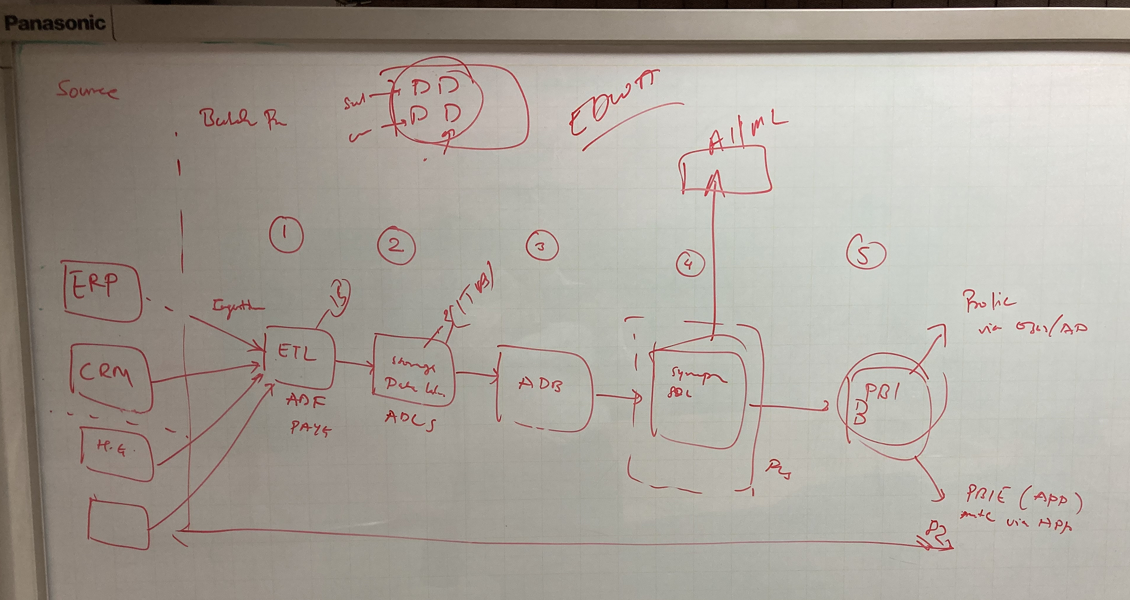
Discussion with MS PowerBI Team
Automatically and reliably ingest and prepare structured and unstructured data at scale in data lakes
a. Simplify your architecture
b. Have data catalog
…..To enable data scientists and BI analysts and others to discover and access data in a self-service way to query the freshest and most complete data using SQL and Power BI.
Build data platform on a microservices architecture that enables modular and repeatable use of data points.
Create rules, standards, or documentation in place for systematically publishing/sharing data between teams for quick interpretation

Slide 4
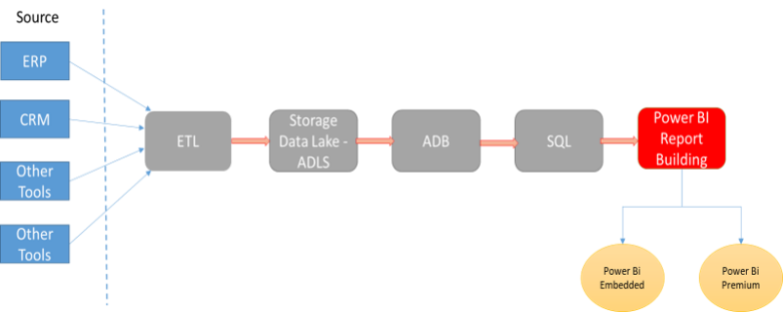
Data Fetching-Cleansing-Processing-Reporting
Enterprise Data Warehouse Architecture
AI/ML
Azure Data Factory
Pay as you use
Azure Data Lake Storage
3K/TB
Azure Data Bricks
ETL
EXTRACT data from its original and multiple sources
TRANSFORM data by Cleansing, Combining & Ensuring quality
LOAD data into the target database
Do we have all this in place
Setting up time for detailed discussion with MS Power BI Team Next week - Nov 7, between 3:30 -4:30 pm

Slide 5
Source System – ADF –Power BI Process Flow
AZURE ADF PROCESS
POWER BI
LN ERP (On Premises DB)
Data Fetching
Data Processing
Data Storing
Pro License
Dataset Generation
CRM (Cloud DB)
AZURE Data Lake Storage
( Blobs, Files, Queues, Tables, and Disks)
Integration Runtime Setup
(Linking Self Hosted Node and Cloud Service)
Data Manipulation activities in AZURE Pipeline
Report and Dashboard Development
Intranet (On Premises DB)
AZURE Synapse Analytics
Deployment in Cloud
Deployment in Report Server (On Premises)
Scheduled/ Event Triggered
Data Ingestion
AZURE SQL DB
Manual File System (On Premises)
Linked Services Configuration
AZURE Data bricks
Embedded
License
Premium Capacity License
SQL Server DB (On Premises)
Dataset Configuration
AI/ML
Non ELGi Domain Users (Business partners)
ELGi Domain Users

Slide 6
Queries to be discussed
What are the AZURE components covered under ADF Account
How Azure SQL DB data is provided to the developers/users i.e. Software as a Service or Platform as a Service
Is Pricing involved in Integration runtime setup and Upgrade between Azure ADF and Different Source Systems
Cost factor for additional storage space if required in future in Cloud.
What is the maximum limit of data storage in Power BI Report Server.
Possibility of sharing the power BI Report data through scheduled Mail system to Users
Advantage of Premium per user License over the Pro License for a Power BI Developer
What is the level of scaling to a Premium capacity License. i.e. How it impacts the cost when there is
increased number of data access from cloud
9. Need to understand the flexibility and features of Power BI Embedded Capacity License

